Slide 1
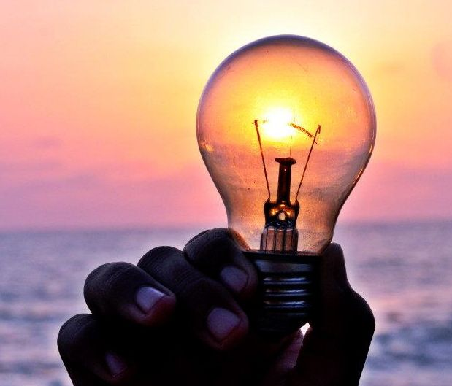
Seasons – Page 1
Earth is like a spinning top on a grand cosmic playground. Unlike some tops you might play with, Earth doesn't sit straight up and down. It's tilted, kinda like leaning to one side. As Earth makes its journey around the Sun, this tilt means different parts of our planet catch more or fewer sunbeams. When a place catches lots of sunbeams, it enjoys a warm summer. But when it gets fewer sunbeams, it snuggles into chilly winter. Isn't it fascinating how a simple tilt can make such a difference?
What toy can we compare Earth to? ___________________________________________________________________
What happens to a place that catches many sunbeams? ___________________________________________________________________
What about a place that gets fewer sunbeams? ___________________________________________________________________
The Sun is like Earth's big, glowing light bulb in the sky. It’s constantly shining, day and night. But thanks to Earth's tilt and its merry dance around the Sun, some places get more sunlight at certain times. Think of Australia; during its summer, it's soaking up the Sun's rays, getting all warm and sunny. Then, in winter, it gets a tad less of that golden light, leading to cooler days. All this, and the Sun stays right where it is, never coming closer or moving away!
Does the sun shine only during the day? ___________________________________________________________________
What happens in Australia during summer? ___________________________________________________________________
How is winter in Australia different from its summer? ___________________________________________________________________

Slide 2
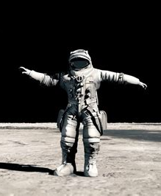
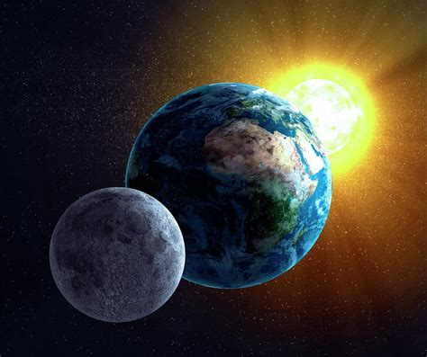
Seasons – Page 2
Our nighttime friend, the Moon, might not give us seasons, but it has its own magic. It's like Earth's partner in a grand cosmic dance. The Moon affects our oceans with its gravitational pull. When it's closer in its dance with Earth, it tugs the waters causing high tides. But when it twirls farther away, we see low tides. So, every time you see the waves rising or falling at the beach, you can thank the Moon for its beautiful waltz with our planet!
Does the moon help in changing our seasons? __________________________________________________________________
What happens to the ocean when the moon is closer? __________________________________________________________________
What about when the moon is further away? __________________________________________________________________
Picture a ballroom with three dancers: Sun, Earth, and Moon. The Sun, ever so radiant, stays in one spot, casting its glow. Earth, with its elegant tilt, orbits around the Sun, changing its seasons as it goes. Then there’s the Moon, Earth's loyal partner, moving in sync and affecting our tides. These three cosmic dancers work in harmony. They ensure our world experiences a mix of warm summers, chilly winters, and rhythmic tides. What a mesmerizing performance they give every single day!
What role does the sun play in this dance? __________________________________________________________________
How does Earth’s dance affect our seasons? __________________________________________________________________
What does the moon influence on Earth with its dance? __________________________________________________________________

